Slide 1

NLP PROJECT
Next word prediction using lstm
Name: Khushal Yadav
Roll No. 21CSU188

Slide 2
INTRODUCTION
Next word prediction is a fascinating problem that involves developing a model capable of predicting the most probable word to follow a given sequence of words in a sentence. This predictive model harnesses the power of algorithms and language patterns to anticipate the next word, enabling various applications such as predictive keyboard suggestions, writing assistance, and content generation.
Our task is to develop a robust Next Word Prediction model that can accurately forecast the most appropriate word following a given sequence of words. By analyzing the dataset, our model should learn the linguistic patterns and relationships that govern the progression of words.

Slide 3

DATASET USED
For this task, we are given a textual dataset based on the renowned book series featuring the brilliant detective, Sherlock Holmes. These stories serve as a rich source of textual data, allowing us to delve into the language patterns and contextual relationships.
Dataset Link: https://statso.io/wp-content/uploads/2023/07/book.zip

Slide 4
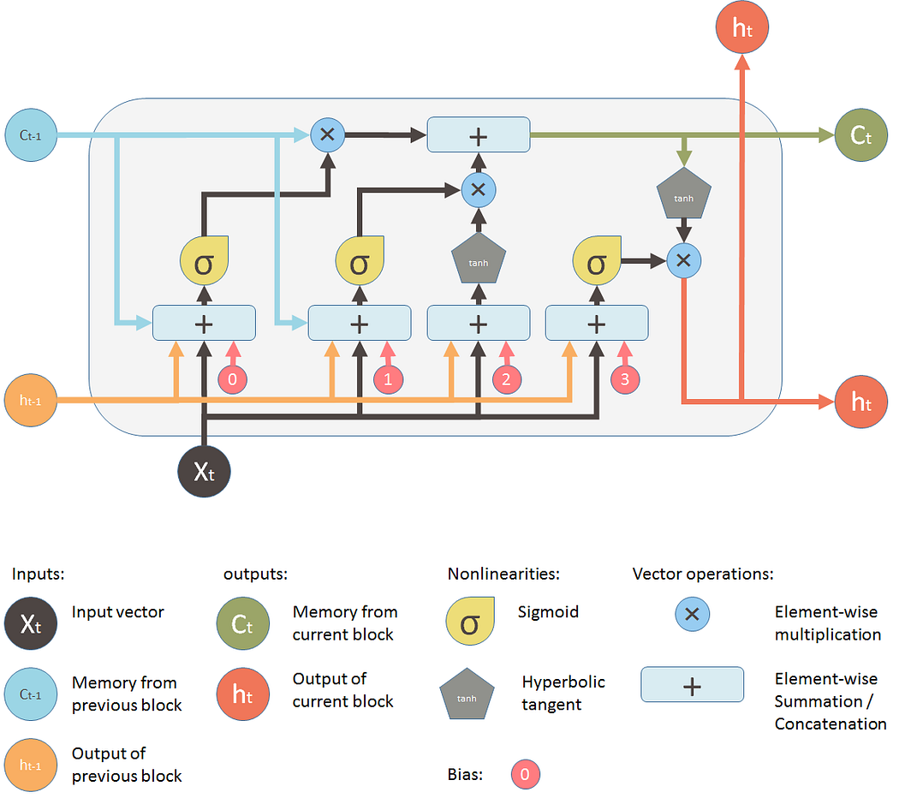
LSTM(Long Short-Term Memory)
LSTM (Long Short-Term Memory) is a type of neural network used for processing sequences of data, like text or time series. It helps the model remember important information for a long time and forget irrelevant details. LSTM is especially useful for tasks like language translation, speech recognition, and text prediction, where understanding context over time is crucial.

Slide 5

CHANGING THE MODEL
We used the LSTM model to predict the next word based on the input text. Now, let's apply another model, DistilBERT, to predict the next word using the same input text and dataset. DistilBERT: DistilBERT is a smaller, faster version of the BERT model. It is designed to retain most of BERT’s accuracy while being more efficient. DistilBERT works well for tasks like text classification, question answering, and text prediction, but with reduced computation time and memory usage.

Slide 6
LSTM VS DistilBERT
 | LSTM | DistilBert
Model Type | Recurrent Neural Network (RNN) | Transformer-based model
Architecture | Sequential, processes one step at a time | Parallel processing of input data
Performance | Slower for long sequences | Faster and more efficient than BERT
Use Case | Suitable for time-series and text data | Best for NLP tasks like text classification, and question answering

Slide 7

Which is Better?
DistilBERT generally outperforms LSTM for most natural language processing tasks due to its ability to understand complex context and process entire sequences in parallel, making it ideal for tasks like text classification, language understanding, and next-word prediction. Unlike LSTM, which processes data sequentially and struggles with retaining long-term context, DistilBERT leverages its transformer architecture to capture broader relationships across words in a sentence
Overall, DistilBERT is better suited for sophisticated NLP applications, while LSTM remains valuable for specific, resource-constrained tasks.

Slide 8


